Slide 1
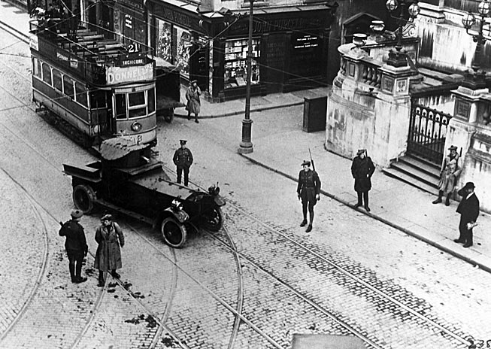
The Sniper by Liam O’Flaherty

Slide 2
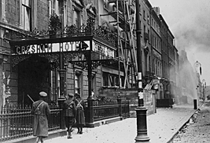
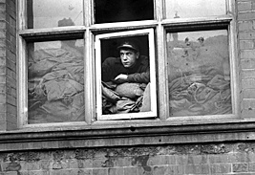
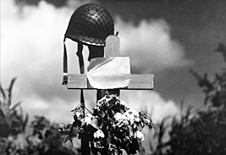
The Sniper
Introducing the Story
“War: first, one hopes to win; then one expects the enemy to lose; then, one is satisfied that he too is suffering; in the end, one is surprised that everyone has lost.”
Karl Kraus, Austrian satirist, 1917

Slide 3
The Sniper
Introducing the Story
A sniper hides on a rooftop. He lights a cigarette, and the flash from the match gives him away to the enemy. Will he get off the rooftop alive?
  “The Sniper” takes place over a brief period of time, but it is packed with suspense. How do you think the character will react to being under fire and alone?

Slide 4
The Sniper
Literary Focus: Theme and Conflict
  “The Sniper” focuses on the life-and-death conflict between the sniper and an enemy soldier.
  As you read, decide what idea about war the writer communicates through the sniper’s experiences.

Slide 5

The Sniper
Background
This story is set in Dublin, Ireland, in the 1920s, during a time of bitter civil war. On one side were the Republicans; they wanted all of Ireland to become a republic, totally free from British rule.
On the other side were the Free Staters; they had compromised with Britain and had agreed to allow the English to continue to rule six counties in the northern province of Ulster.

Slide 6
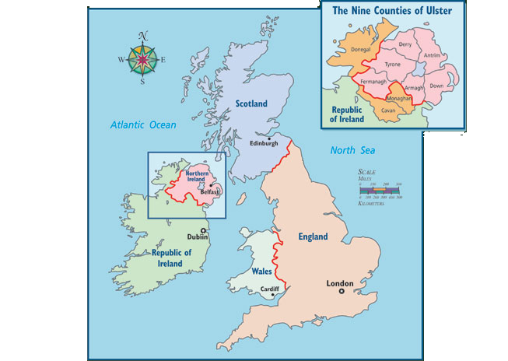
The Sniper
Background

Slide 7
The Sniper
Background
Like all civil wars, the Troubles in Ireland tore families apart. It pitted children against parents, sister against sister, brother against brother. As the story opens, the writer immediately puts you into the war—high on a Dublin rooftop.

Slide 8
The Sniper
Vocabulary
Previewing the Vocabulary
beleaguered v. used as adj.: surrounded and under attack.
ascetic adj.: severe; also, self-disciplined.
fanatic n.: person whose extreme devotion to a cause is excessive or unreasonable.
ruse n.: trick.
silhouetted v. used as adj.: outlined.
remorse n.: deep guilt.

Slide 9
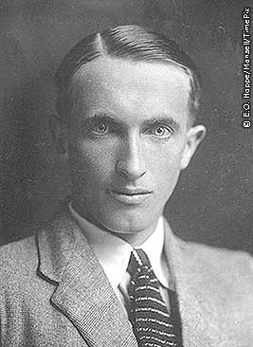
The Sniper
Meet the Writer
Liam O’Flaherty (1896-1984) was born to a large, impoverished family on Inishmore, one of Ireland’s rocky Aran Islands. His father was a farmer and fisherman, and his mother was the descendant of lighthouse builders.
O’Flaherty took inspiration from his native Aran Islands, writing frequently about peasant life.

